Slide 1

2019
Department
Of Computer
Science
&
Electrical And
Electronics
Engineering
MATH-IV
KAS -402
2020-2021
Dr.Rupa Sharma
Associate Professor
vsrsrsys@gmail.com

Slide 2
Measures of central Tendency Or Averages

Slide 3
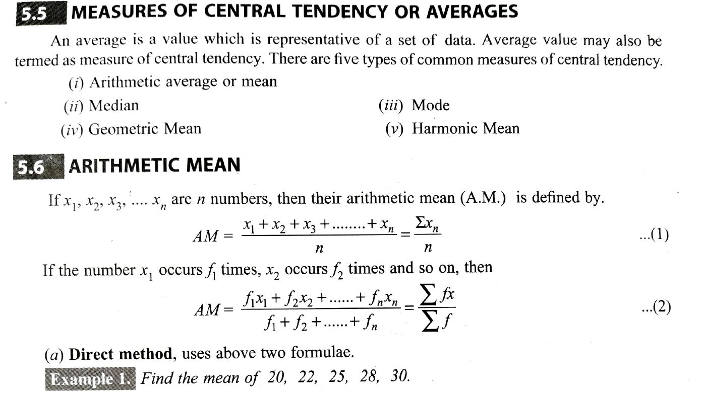

Slide 4
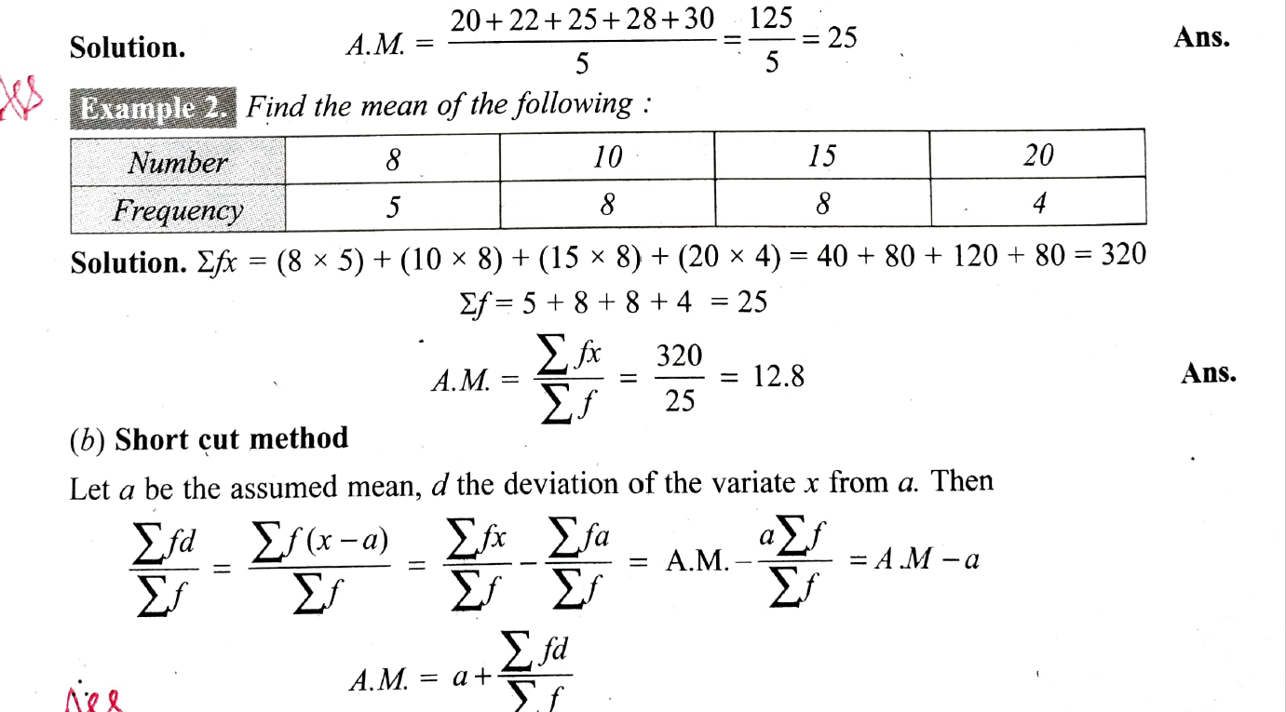

Slide 5

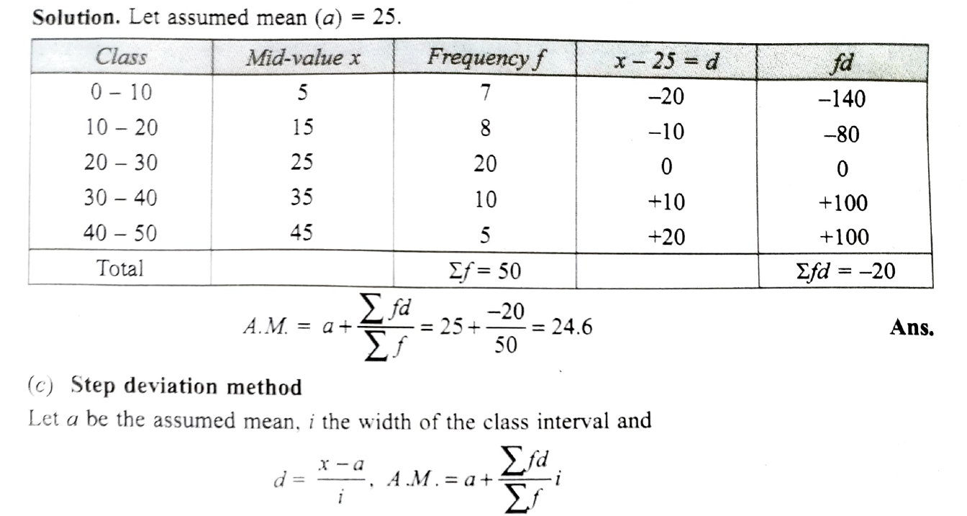

Slide 6
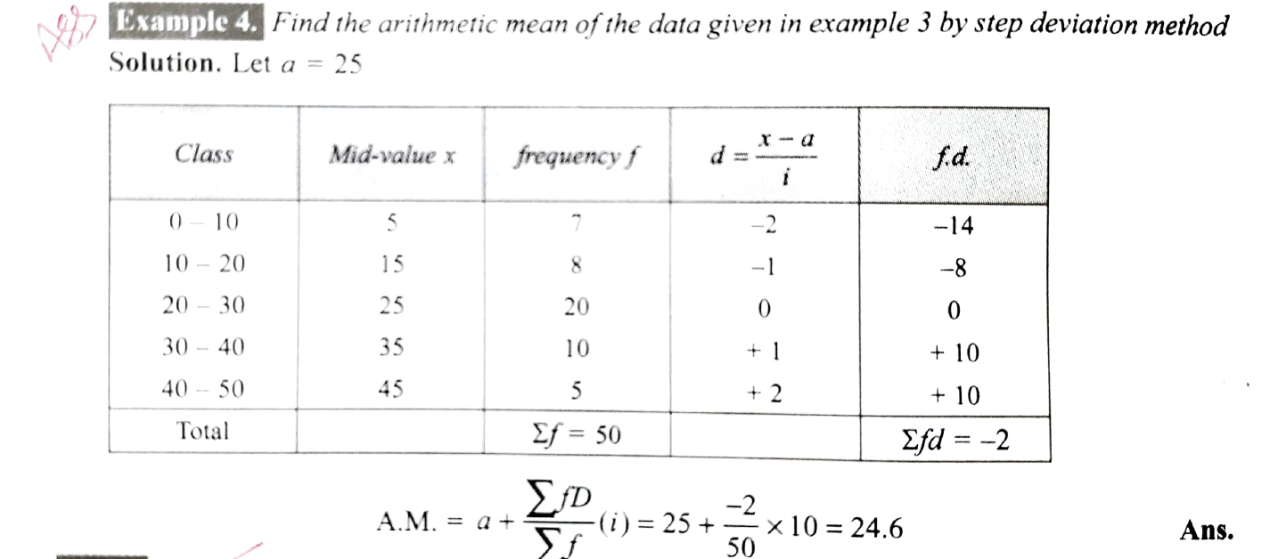

Slide 7



Slide 8
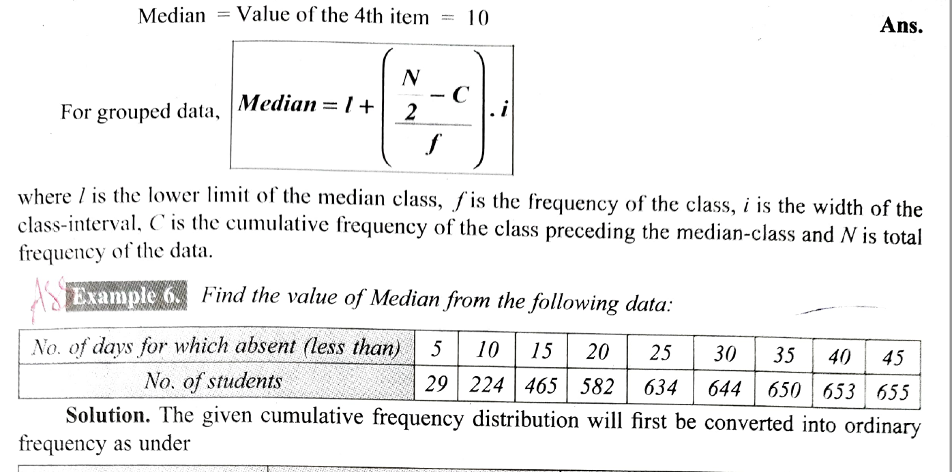

Slide 9
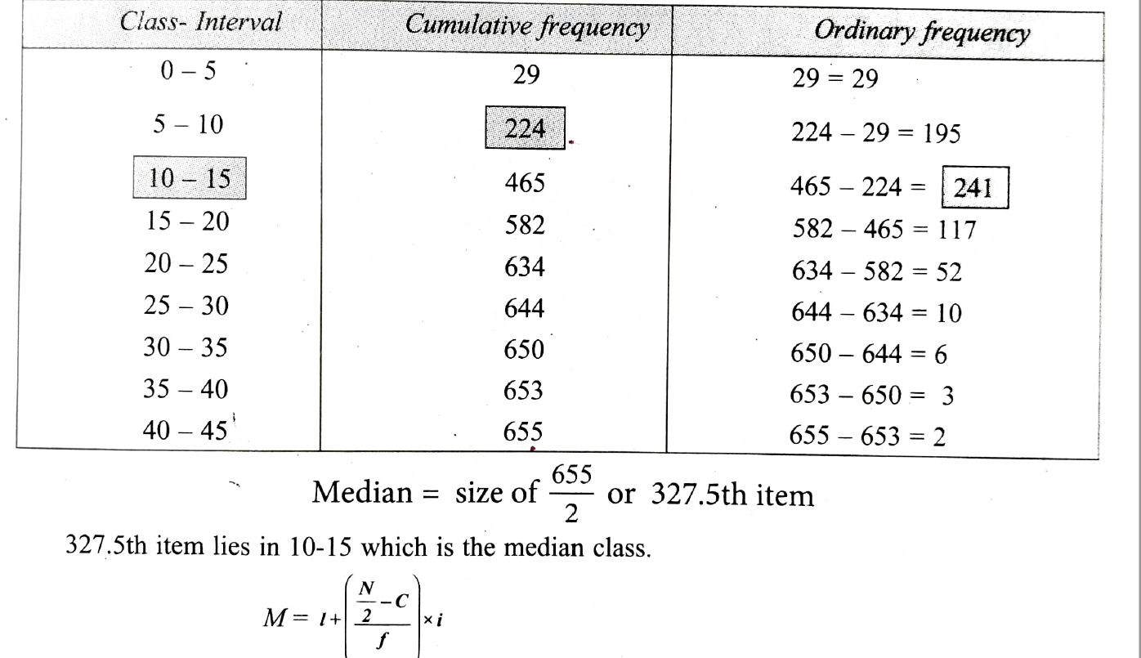

Slide 10
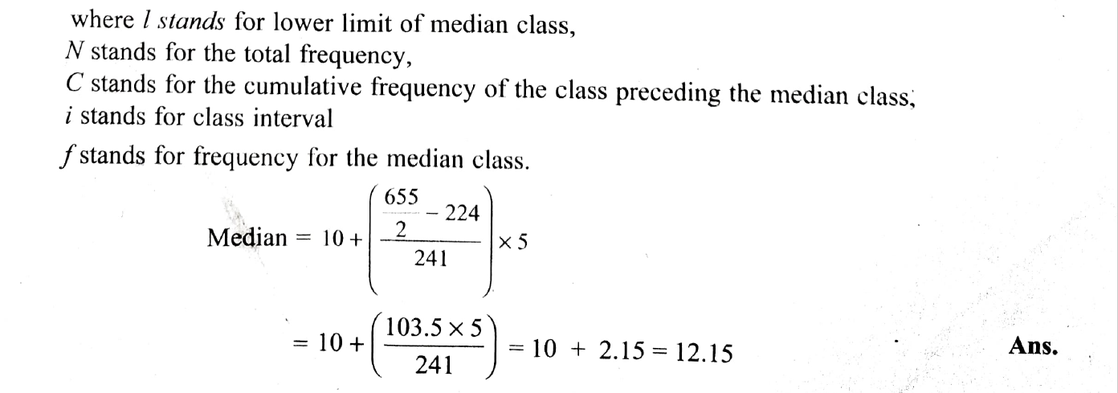

Slide 11
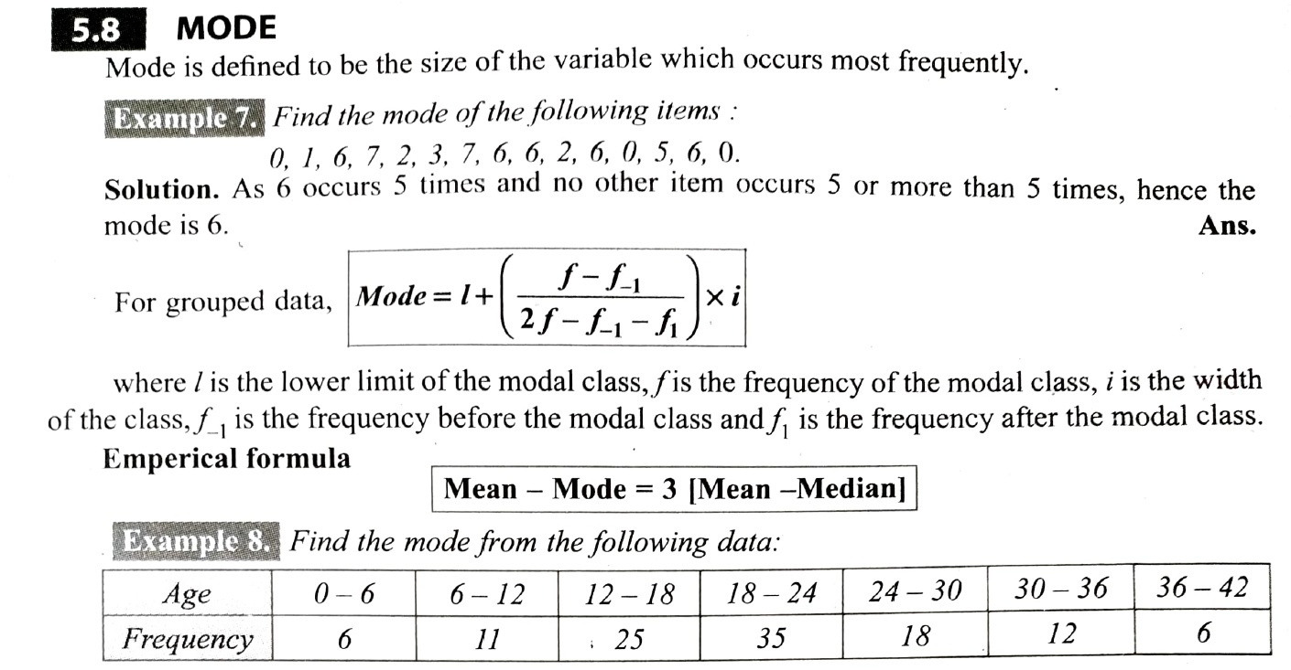

Slide 12
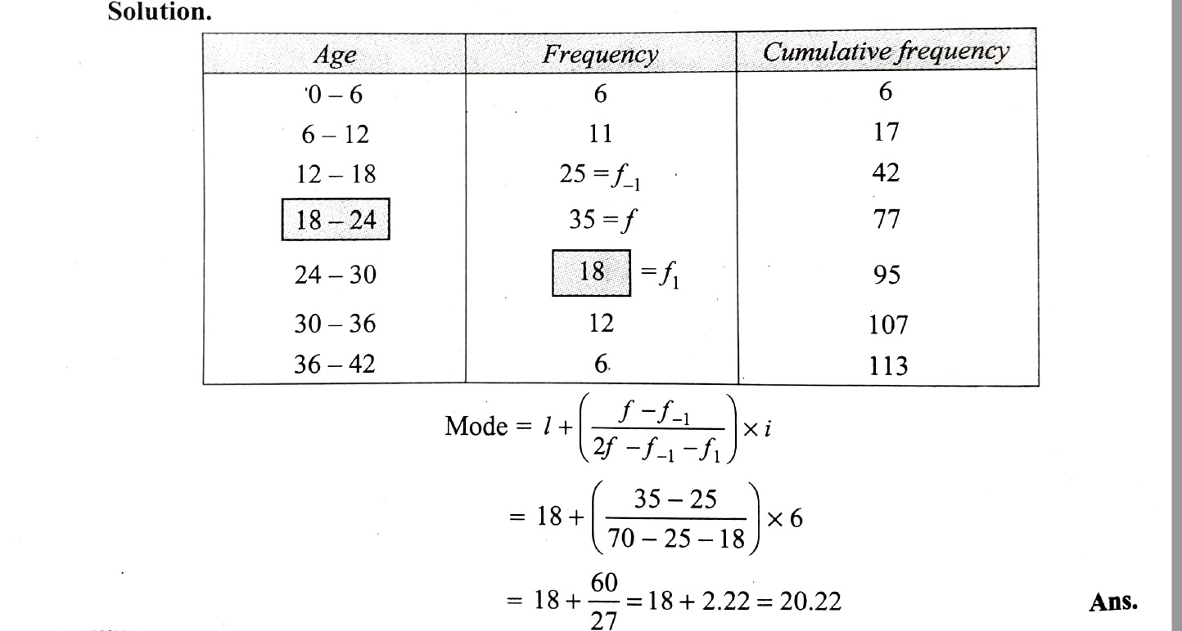

Slide 13
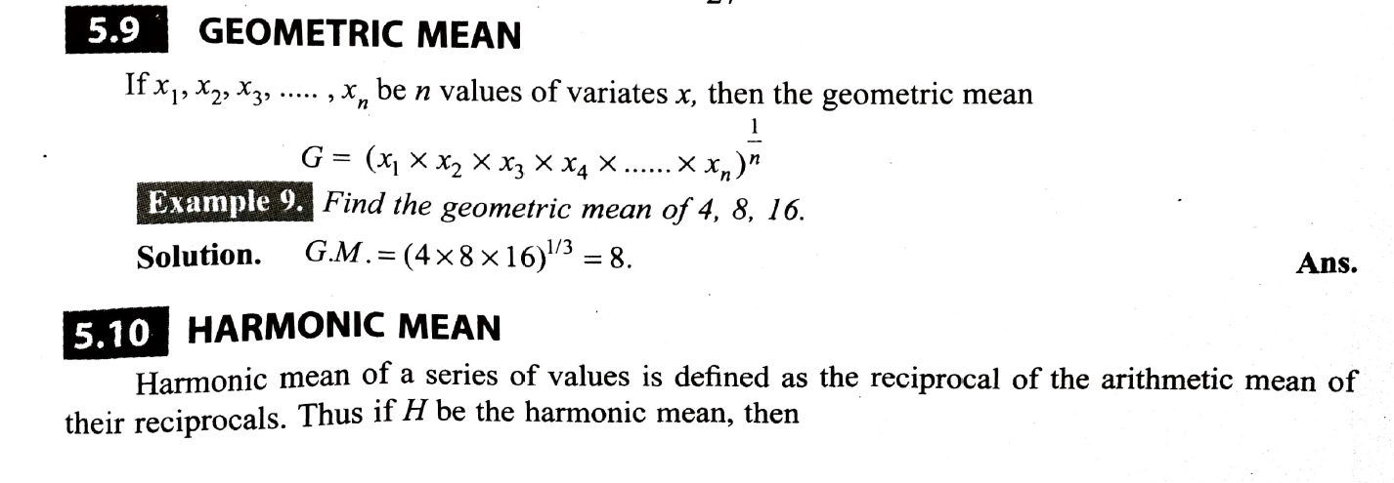


Slide 14
THANK YOU

